Slide 1
ELE419 IC Design Project
Physical VLSI Design of 8-bit ALU with Extended Opcode Set
Ömer Yanmaz 2210357025

Slide 2
Literature Review
Full Adder Design
In this work, a conventional full adder architecture was used for the arithmetic operations of the 8-bit ALU. The conventional full adder is widely preferred in digital circuit design due to its simplicity, reliability, and ease of implementation using basic logic gates. It consists of two XOR gates, two AND gates, and one OR gate to generate the sum and carry outputs. This structure provides stable operation and is commonly used in educational and industrial VLSI designs.
Reference:
Rabaey, J. M., Chandrakasan, A., & Nikolić, B. Digital Integrated Circuits: A Design Perspective. Prentice Hall, 2003.
Weste, N. H. E., & Harris, D. CMOS VLSI Design: A Circuits and Systems Perspective. Pearson, 2011.
Shift Operation Design
For shift operations in the ALU, buffer-based shift logic was implemented. Buffers are commonly used in shift operations to ensure proper signal propagation and to minimize delay caused by loading effects. Using buffers provides fast and reliable data transfer between stages, making them suitable for high-speed digital circuits such as ALUs.
Reference:
Kang, S. M., & Leblebici, Y. CMOS Digital Integrated Circuits: Analysis and Design. McGraw-Hill, 2003.
Mano, M. M., & Ciletti, M. Digital Design. Pearson Education, 2017.

Slide 3
Literature Review
In this work, the multiplexer (MUX) is implemented using transmission gate (TG) logic instead of conventional CMOS logic. Transmission gates are widely used in VLSI design due to their reduced transistor count, lower power consumption, and improved signal integrity compared to standard CMOS gate-based multiplexers.
Compared to conventional CMOS MUX implementations, which often require a larger number of transistors, transmission gate–based designs significantly reduce hardware complexity. For example, a 2:1 multiplexer implemented using transmission gates typically requires fewer transistors than a logic-gate-based design, making it highly efficient for ALU architectures where multiple multiplexers are used.

Slide 4
Literature Review
Basic logic gates such as NAND, NOR, and XOR are foundational components in digital circuits, including Arithmetic Logic Units (ALUs). In CMOS VLSI design, these gates are implemented using complementary pairs of p-type and n-type MOSFETs, which provide low static power consumption and robust switching behavior.
The NAND and NOR gates are considered universal gates because they can be combined to construct any other Boolean function. In algebraic terms:
NAND outputs logic ‘0’ only when all inputs are logic ‘1’.
NOR outputs logic ‘1’ only when all inputs are logic ‘0’.
The XOR gate, while not universal in the strict sense, is crucial for arithmetic functions (especially adders). A typical CMOS XOR is built from combinations of NAND/NOR structures to achieve the required logic.
In conventional VLSI design methodologies, these gates are optimized for delay, power, and area, making them suitable for implementation in educational and industrial ALU circuits.
References:
Weste, N. H. E., & Harris, D. CMOS VLSI Design: A Circuits and Systems Perspective. Pearson, 2011.
Rabaey, J. M., Chandrakasan, A., & Nikolić, B. Digital Integrated Circuits: A Design Perspective. Prentice Hall, 2003.

Slide 5
Literature Review
Educational Source — Supporting Material
The fundamental behavior and implementation style of these logic gates in digital circuits and VLSI is also explained in educational materials such as the referenced video tutorial, which provides practical visuals and examples for understanding logic gate behaviors and uses in circuits:
YouTube Tutorial: “CMOS Logic Gates Explained + NAND, NOR, XOR Implementation”, which demonstrates gate operation and CMOS logic principles learned during this project. (Accessed January 2026) — https://www.youtube.com/watch?v=MupsaVTT6iw
Note: While video tutorials are valuable for learning, formal academic sources (textbooks, journals) are used as primary references in the literature review.

Slide 6
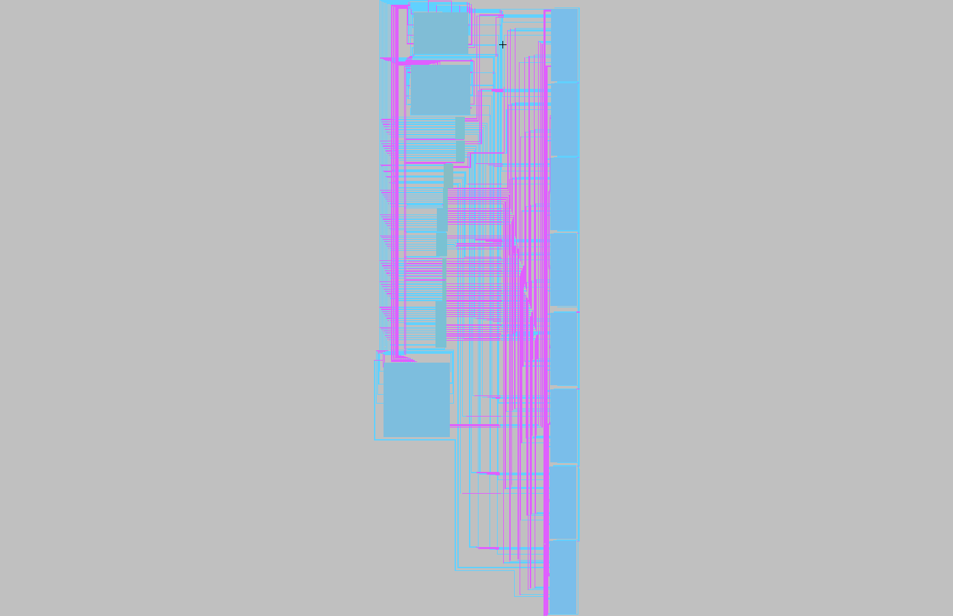
Physical Layout of the Complete Design

Slide 7
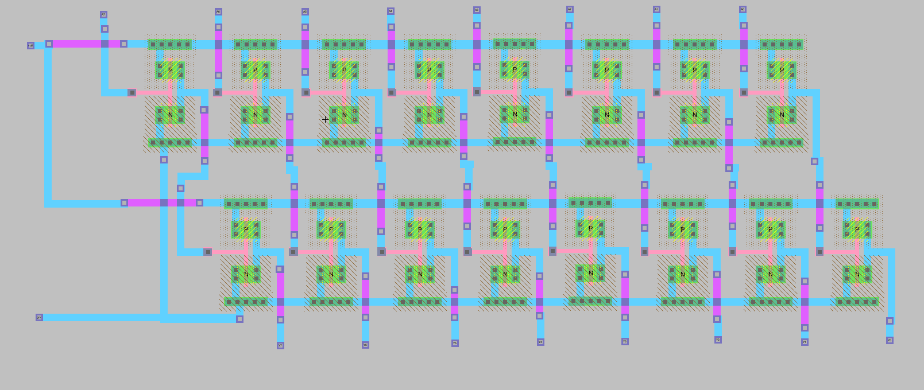
Additional Design Material 8-Bit Buffer Layout

Slide 8
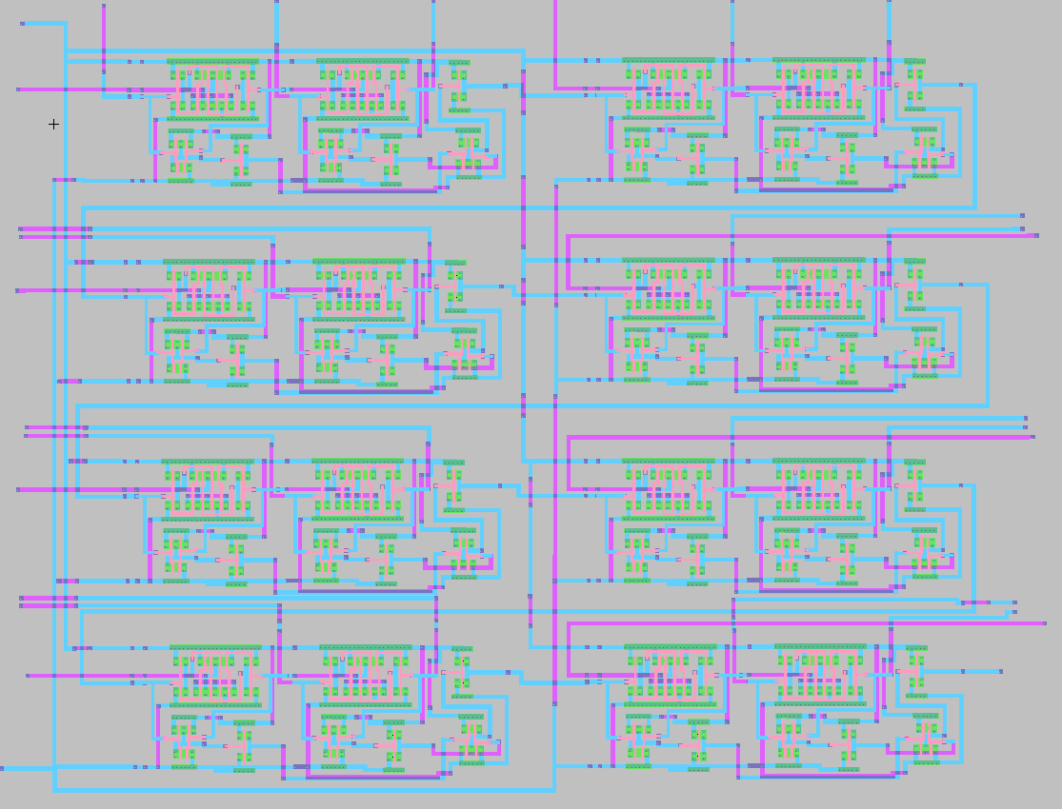
Additional Design Material 8-Bit Full Adder Layout

Slide 9
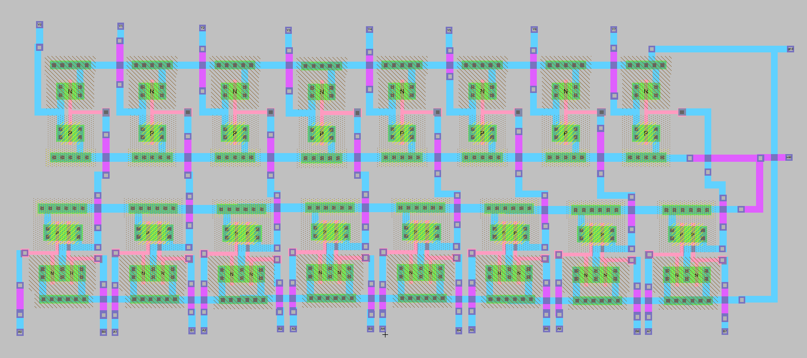
Additional Design Material 8-Bit OR Layout

Slide 10
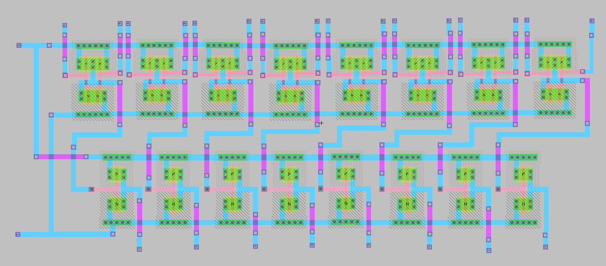
Additional Design Material 8-Bit AND Layout

Slide 11
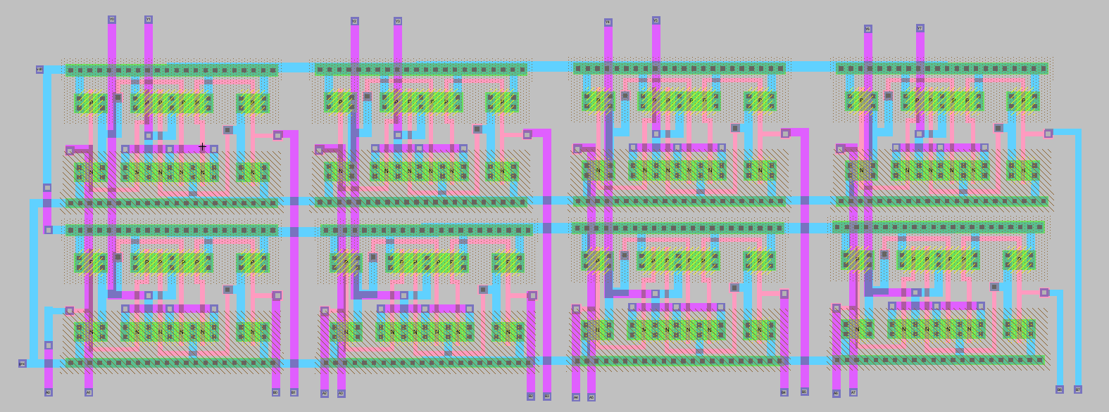
Additional Design Material 8-Bit XOR Layout

Slide 12
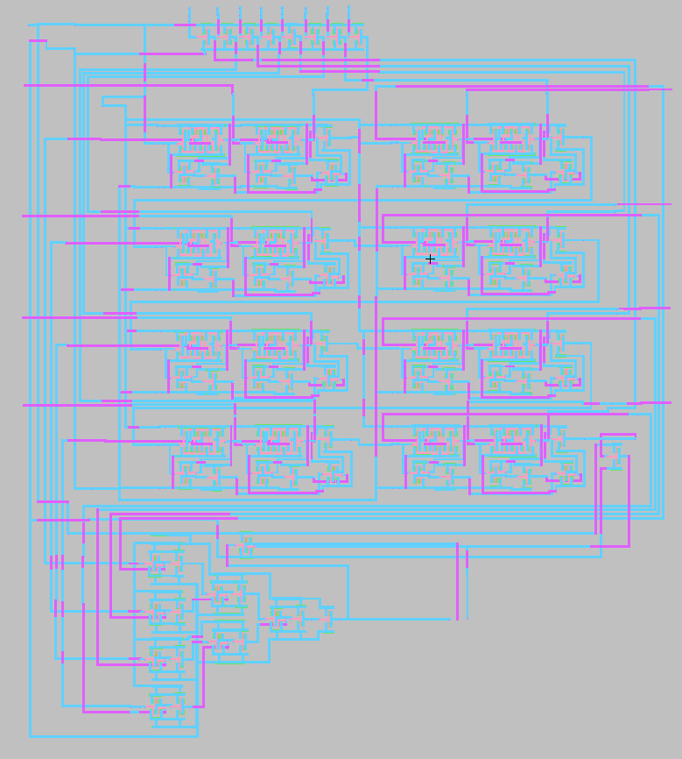
Additional Design Material 8-Bit Comparator (Subtractor Used)

Slide 13
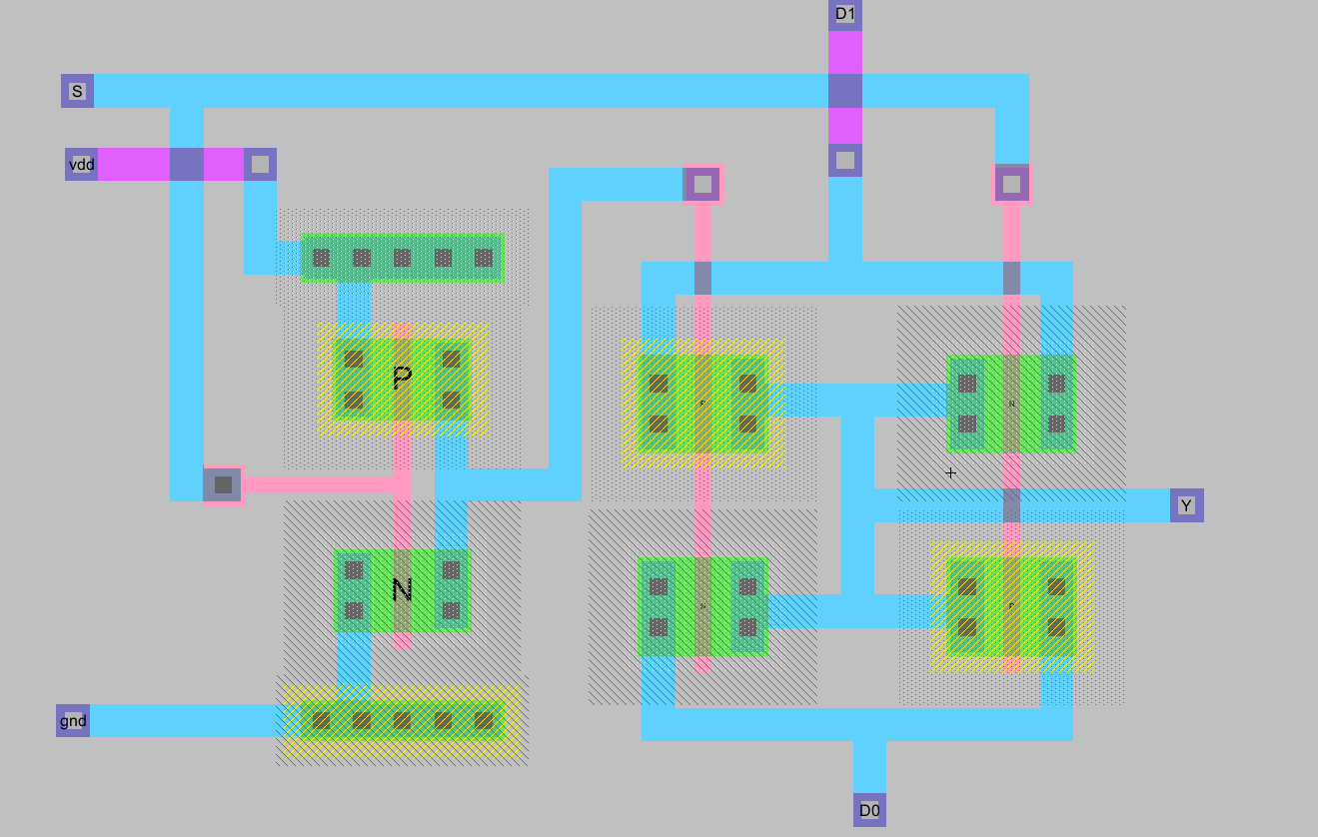
Additional Design Material 2x1 MUX Layout

Slide 14
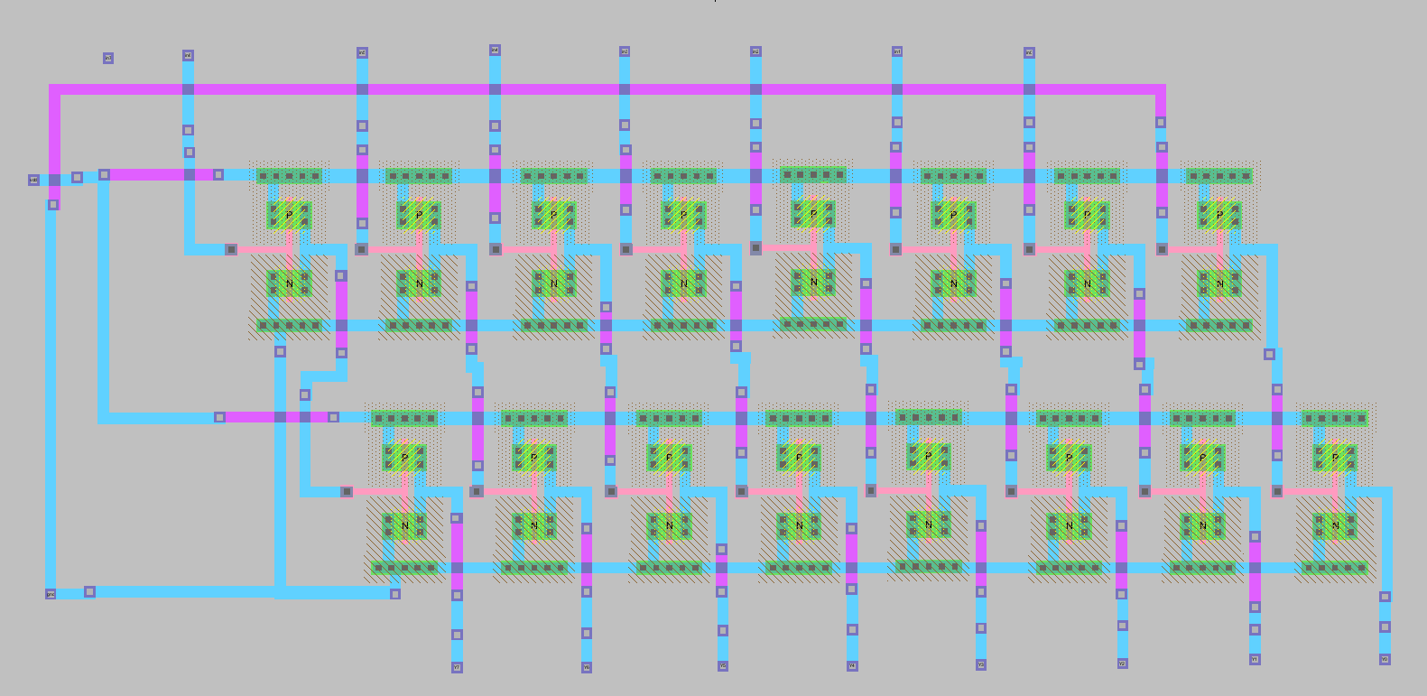
Additional Design Material Left Shift Layout

Slide 15
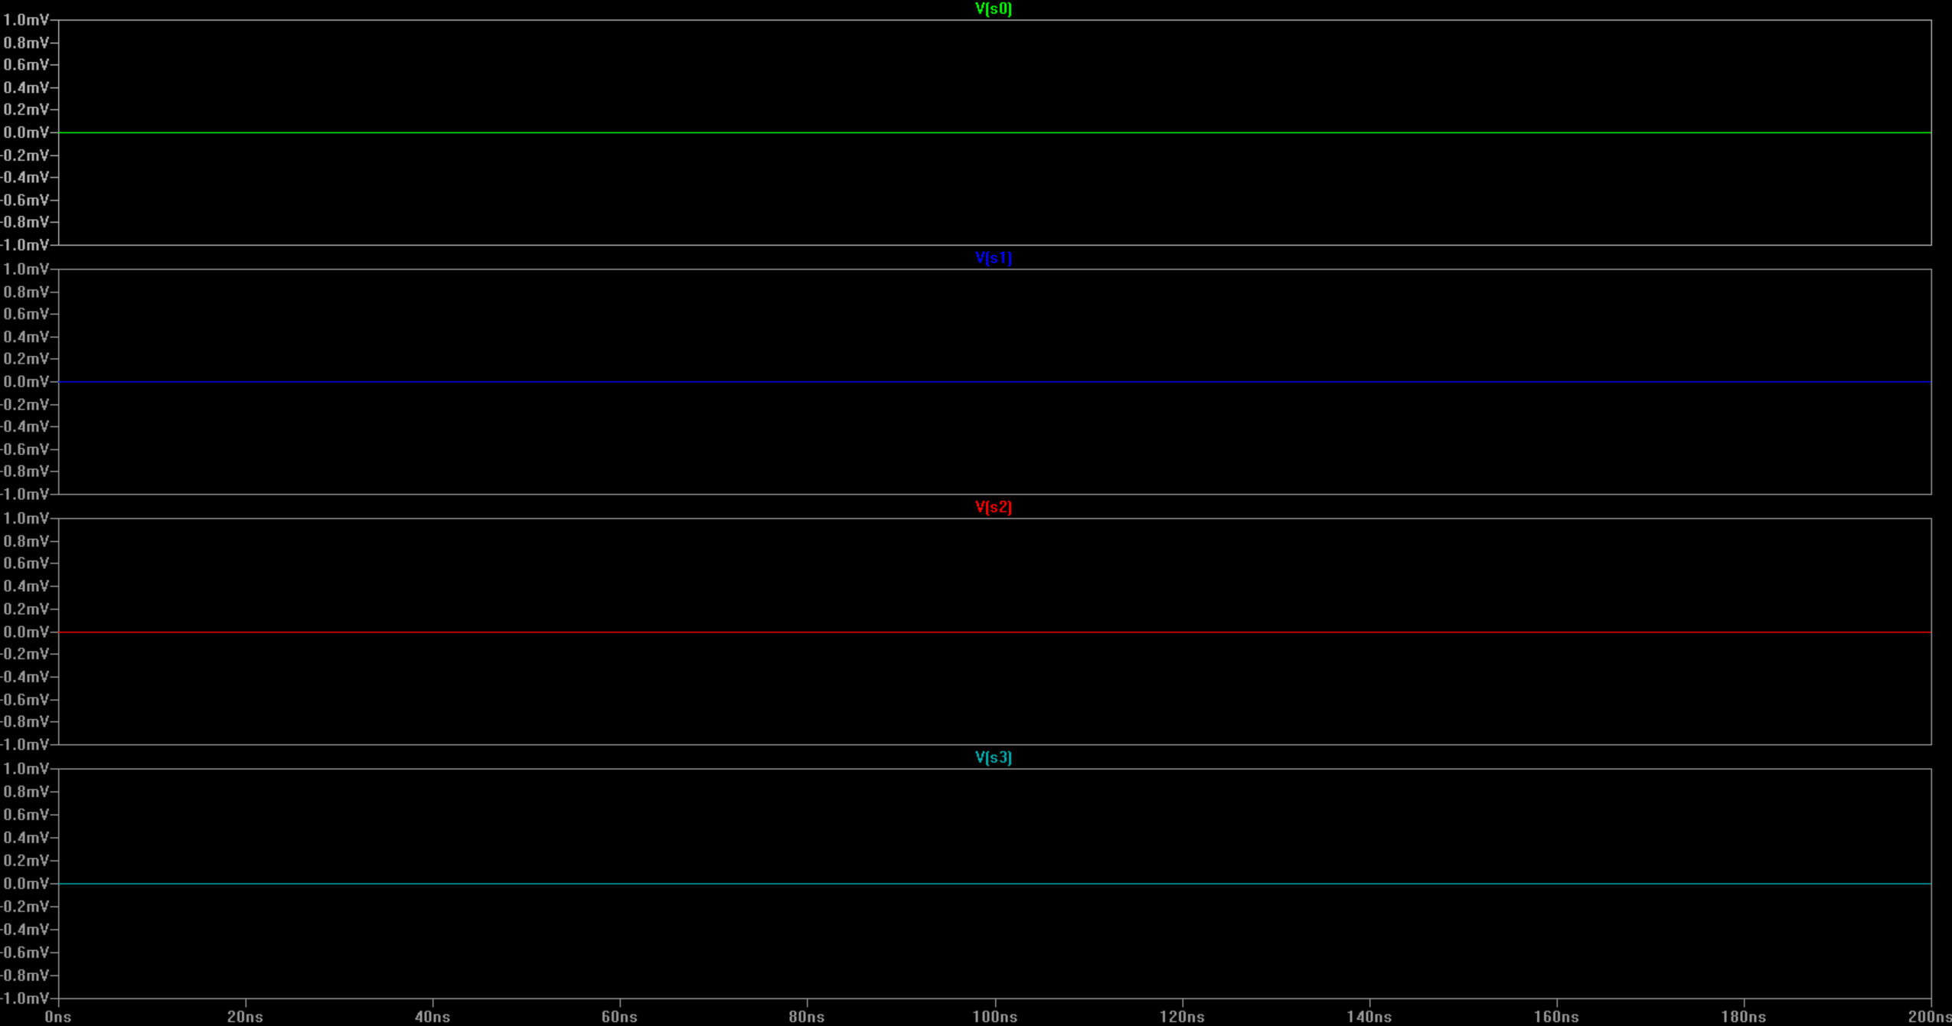
Demonstration of Addition A = 01010101 B = Last 2 digit of my Student ID in binary = 00011001
Opcode | Operation | Expected Answer | Result of the simulation
0000 | A + B | 0110 1110 | 0110 1110

Slide 16
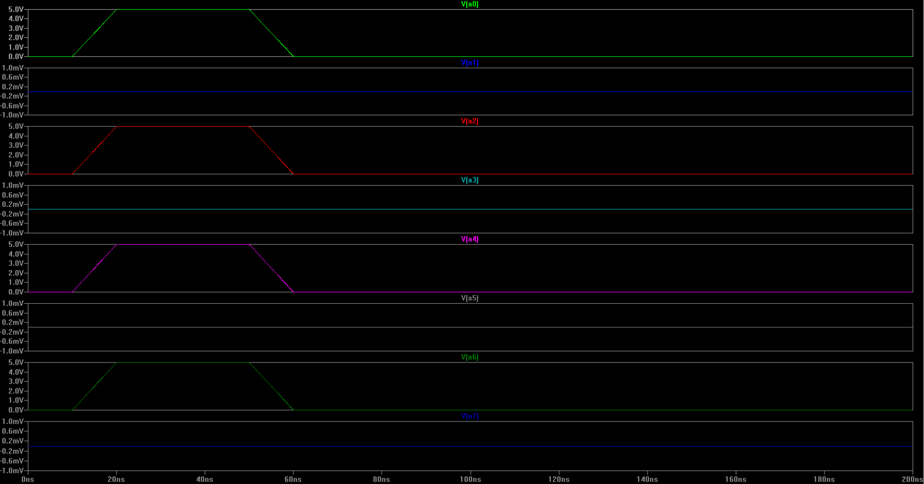
Demonstration of Addition A = 01010101 B = Last 2 digit of my Student ID in binary = 00011001
Opcode | Operation | Expected Answer | Result of the simulation
0000 | A + B | 0110 1110 | 0110 1110
INPUT A
INPUT A

Slide 17
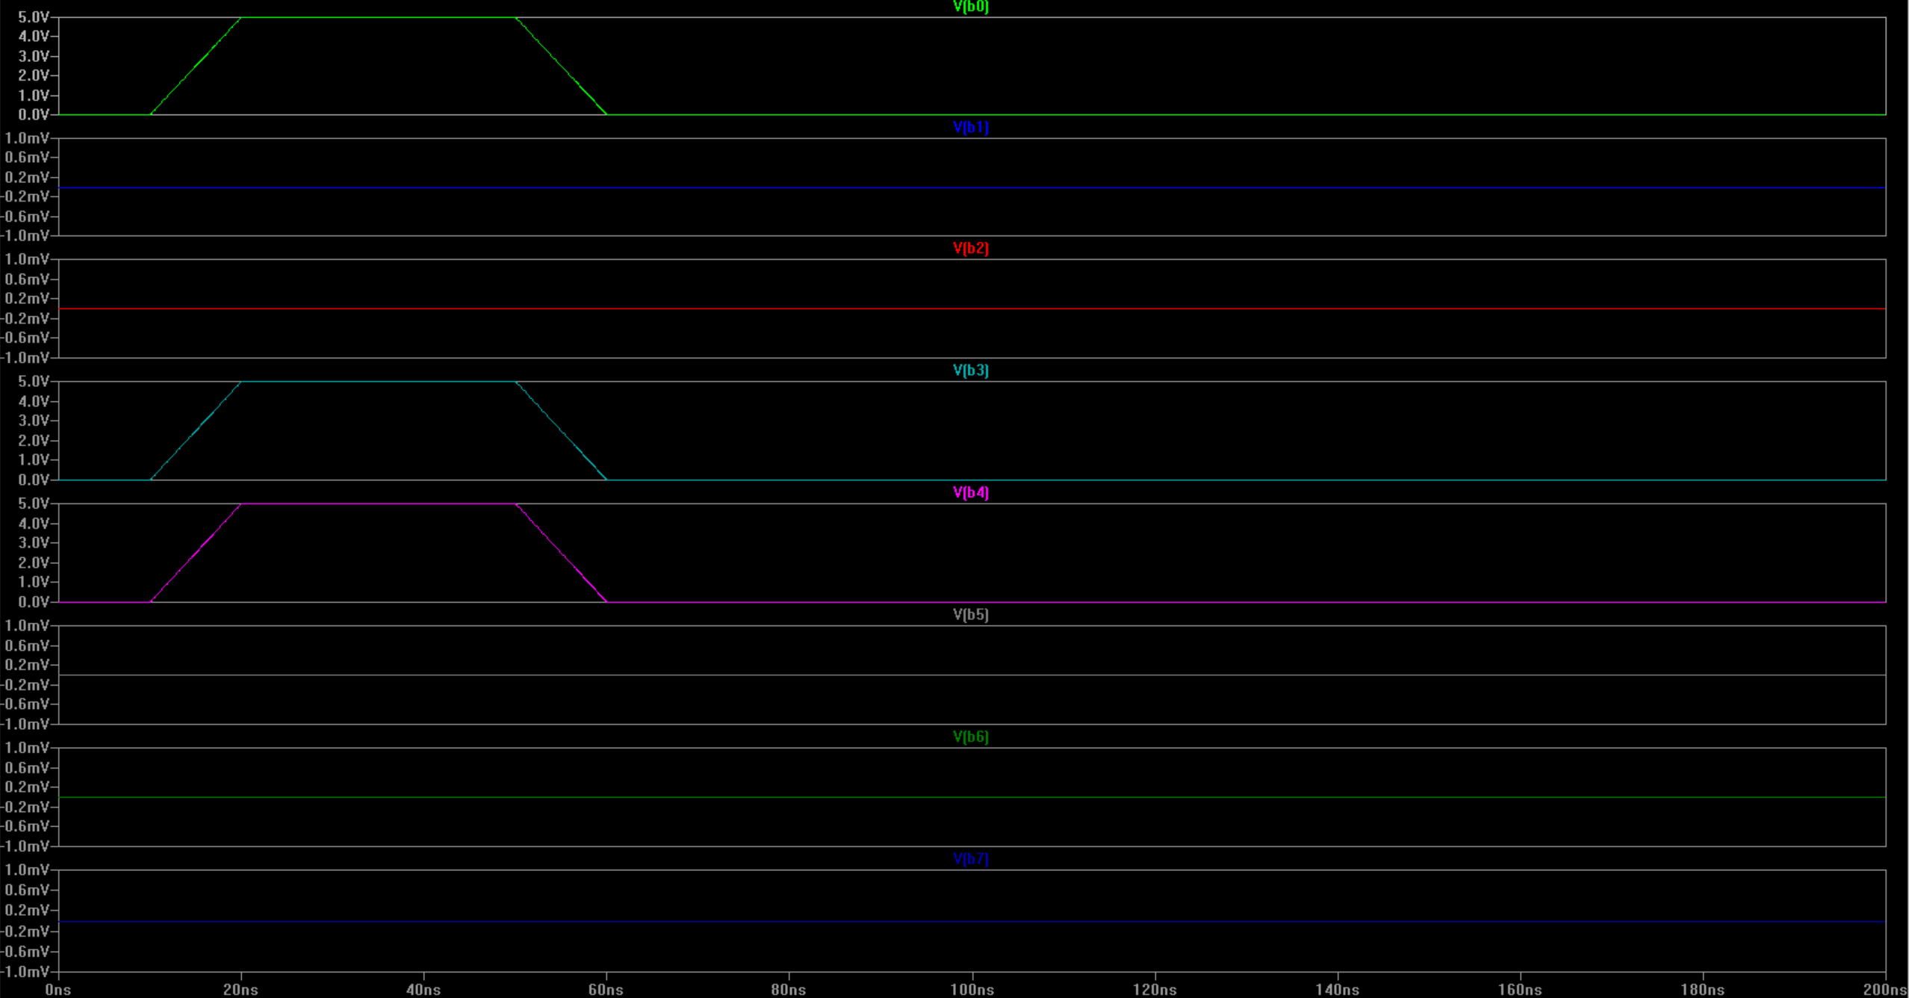
Demonstration of Addition A = 01010101 B = Last 2 digit of my Student ID in binary = 00011001
Opcode | Operation | Expected Answer | Result of the simulation
0000 | A + B | 0110 1110 | 0110 1110
INPUT B

Slide 18
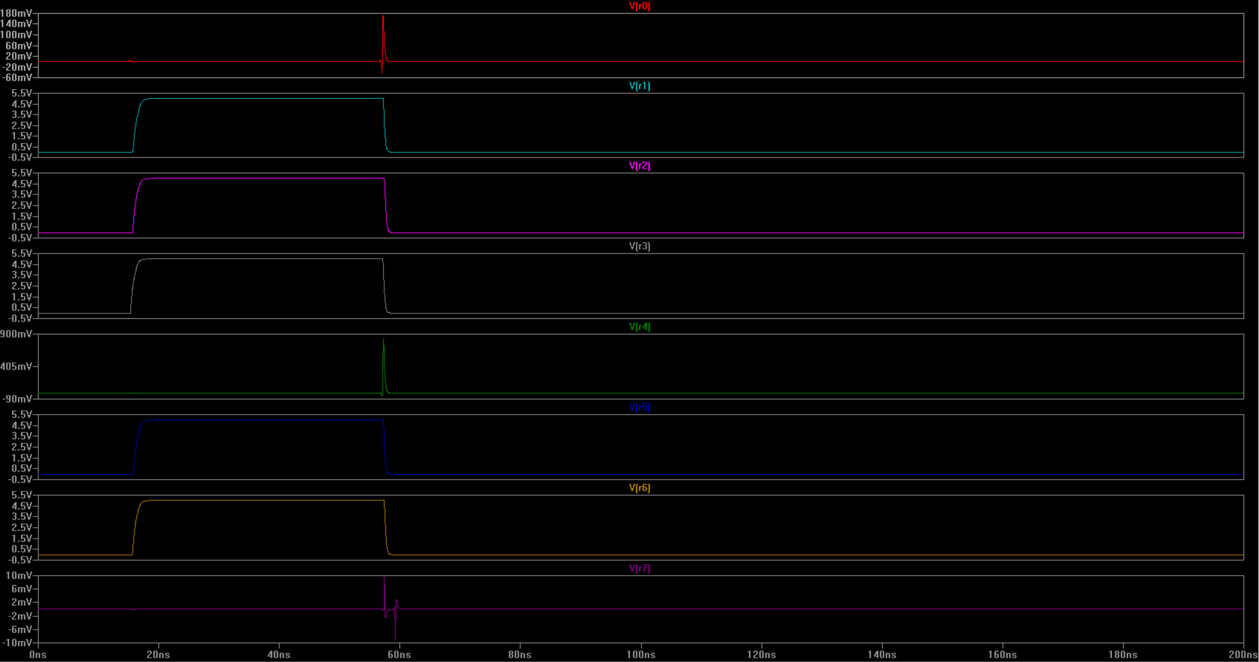
Demonstration of Addition A = 01010101 B = Last 2 digit of my Student ID in binary = 00011001
Opcode | Operation | Expected Answer | Result of the simulation
0000 | A + B | 0110 1110 | 0110 1110

Slide 19
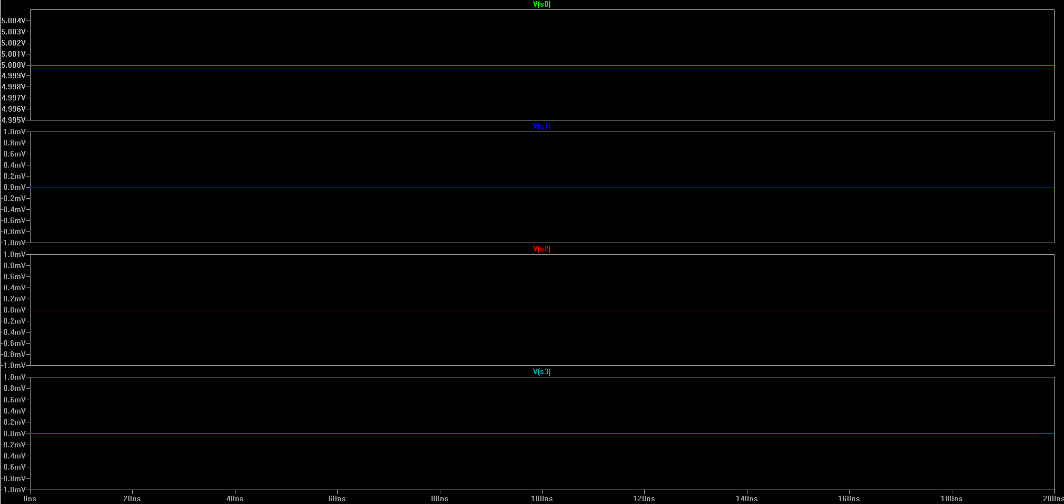
Demonstration of Subtraction Last 2 digit of my Student ID= 00011001 - 1=?
Opcode | Operation | Expected Answer | Result of the simulation
0001 | A - B | 0011 1100 | 0011 1100

Slide 20
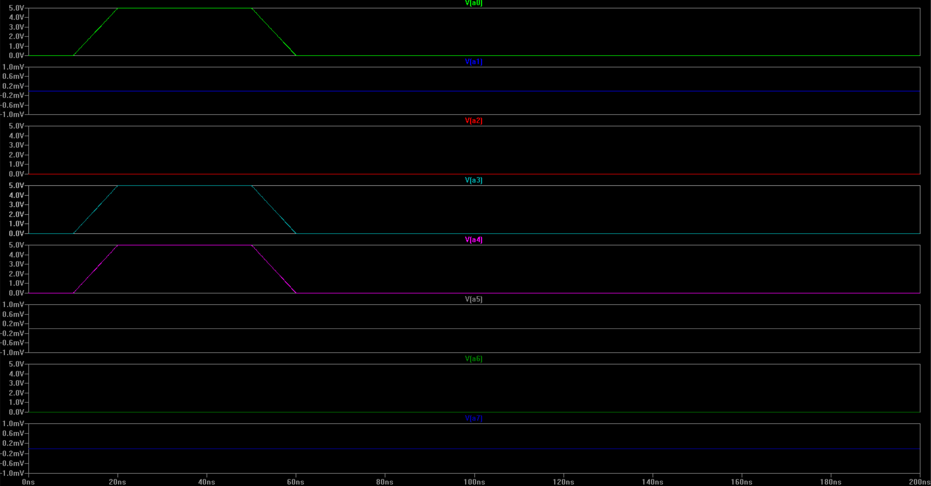
Demonstration of Subtraction Last 2 digit of my Student ID= 00011001 - 1=?
Opcode | Operation | Expected Answer | Result of the simulation
0001 | A - B | 0011 1100 | 0011 1100
INPUT A

Slide 21
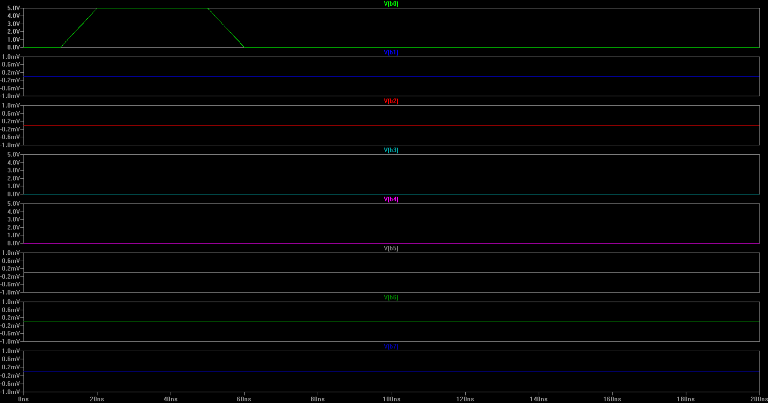
Demonstration of Subtraction Last 2 digit of my Student ID= 00011001 - 1=?
Opcode | Operation | Expected Answer | Result of the simulation
0001 | A - B | 0011 1100 | 0011 1100
INPUT B

Slide 22
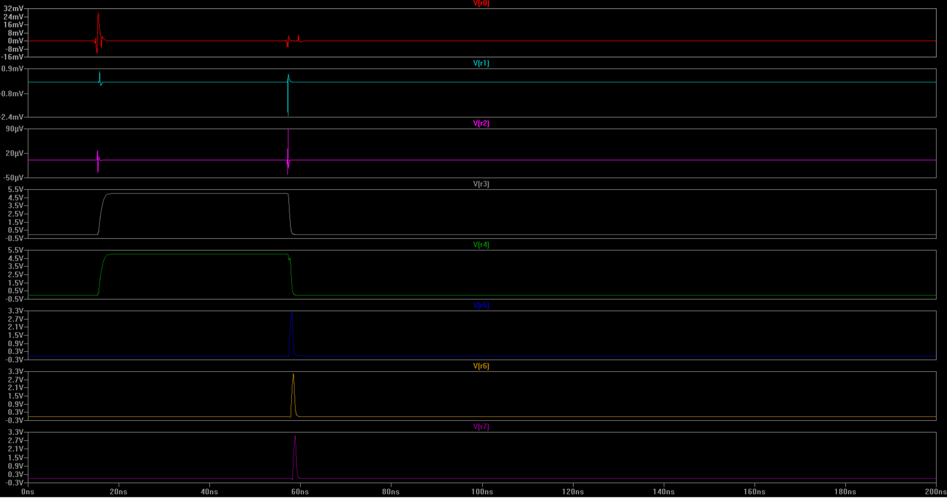
Demonstration of Subtraction Last 2 digit of my Student ID= 00011001 - 1=?
Opcode | Operation | Expected Answer | Result of the simulation
0001 | A - B | 0011 1100 | 0011 1100
I use 8-bit full adder to build subtractor. It has also a overflow flag to detect the sign change.
I used A + B’ +1 equation for subtraction.

Slide 23
Demonstration of “Multiplication” Last 2 digit of you Student ID in binary x 10101=?
Opcode | Operation | Expected Answer | Result of the simulation
1000 | A x B | 0000 1000 0100 1101 | ----
Multiple design iterations were performed, but the implementation could not be finalized because of the high complexity of the system and time constraints.

Slide 24
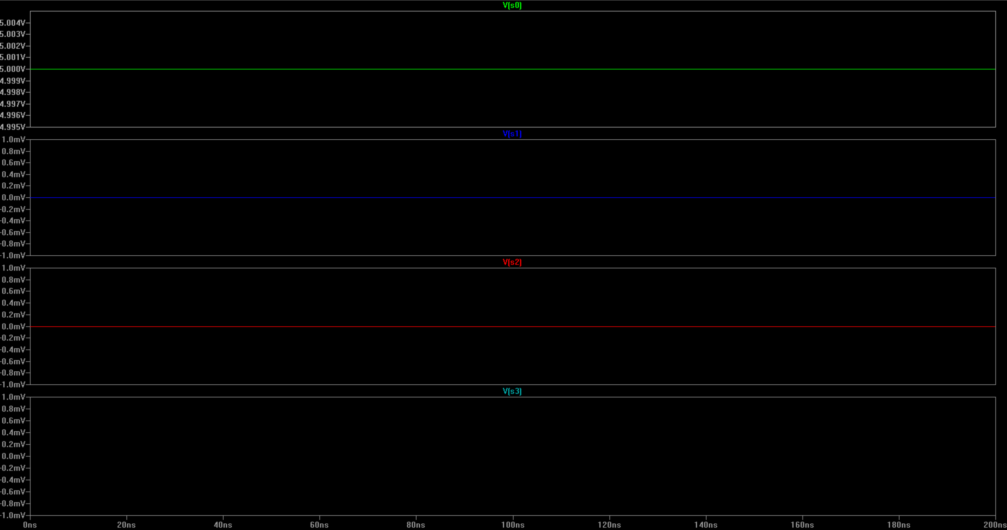
Demonstration of “Equality Check” Last 2 digit of my Student ID= 00011001 == 101=?
Opcode | Operation | Expected Answer | Result of the simulation
1001 | A == B | 00000000 | 00000000

Slide 25
Demonstration of “Equality Check” Last 2 digit of my Student ID= 00011001 == 101=?
Opcode | Operation | Expected Answer | Result of the simulation
1001 | A == B | 00000000 | 00000000
INPUT A

Slide 26
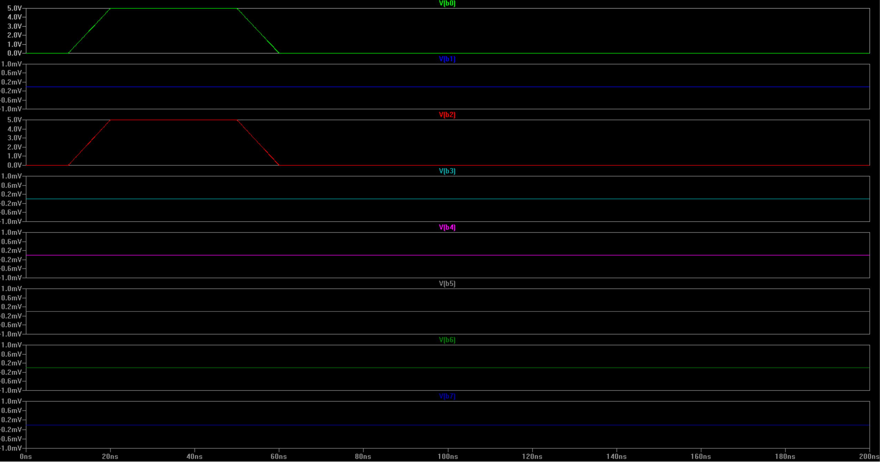
Demonstration of “Equality Check” Last 2 digit of my Student ID= 00011001 == 101=?
Opcode | Operation | Expected Answer | Result of the simulation
1001 | A == B | 00000000 | 00000000
INPUT B

Slide 27
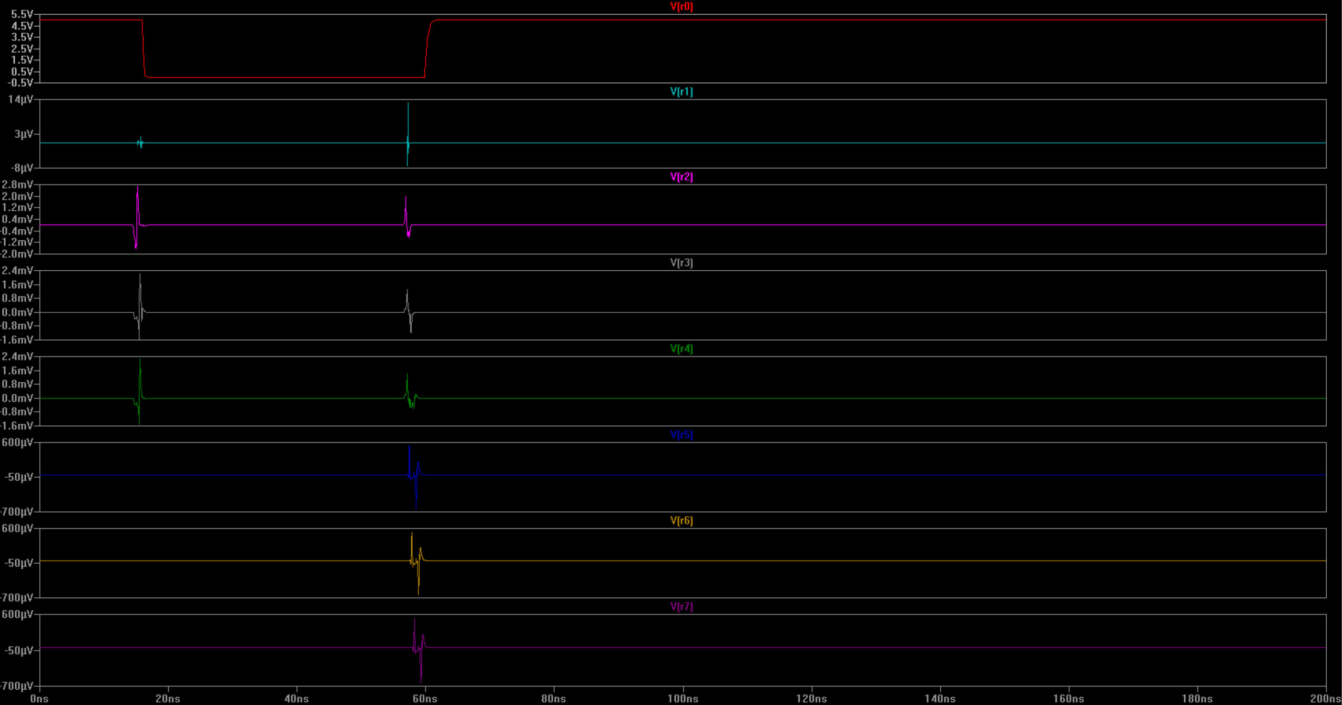
Demonstration of “Equality Check” Last 2 digit of my Student ID= 00011001 == 101=?
Opcode | Operation | Expected Answer | Result of the simulation
1001 | A == B | 00000000 | 00000000
I used subtractor for comparison, I subtracted B from A , then for equality check, I checked that if all outputs are zero or not. If any one of the output bits is logic high then equality is 0.

Slide 28
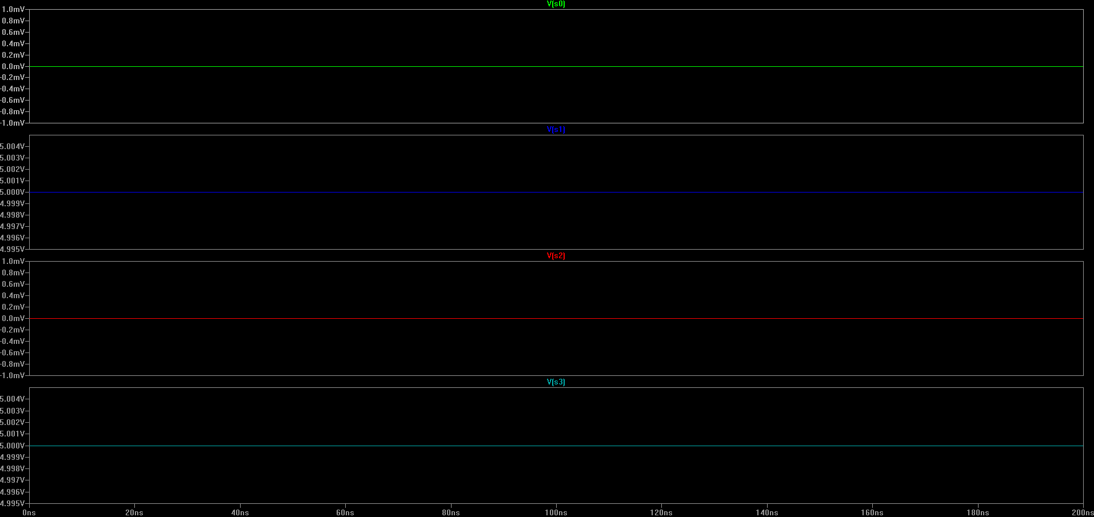
Demonstration of “Greater Than” Last 2 digit of my Student ID= 00011001 > 101=?
Opcode | Operation | Expected Answer | Result of the simulation
1010 | A > B | 0000 0001 | 0000 0001

Slide 29
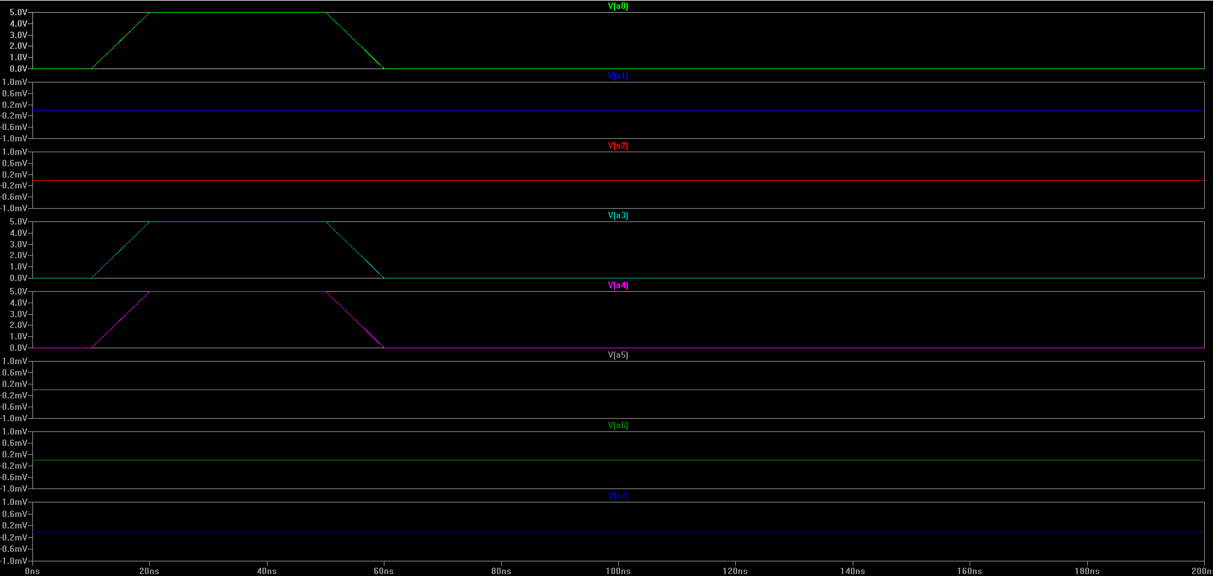
Demonstration of “Greater Than” Last 2 digit of my Student ID= 00011001 > 101=?
Opcode | Operation | Expected Answer | Result of the simulation
1010 | A > B | 0000 0001 | 0000 0001
INPUT A

Slide 30
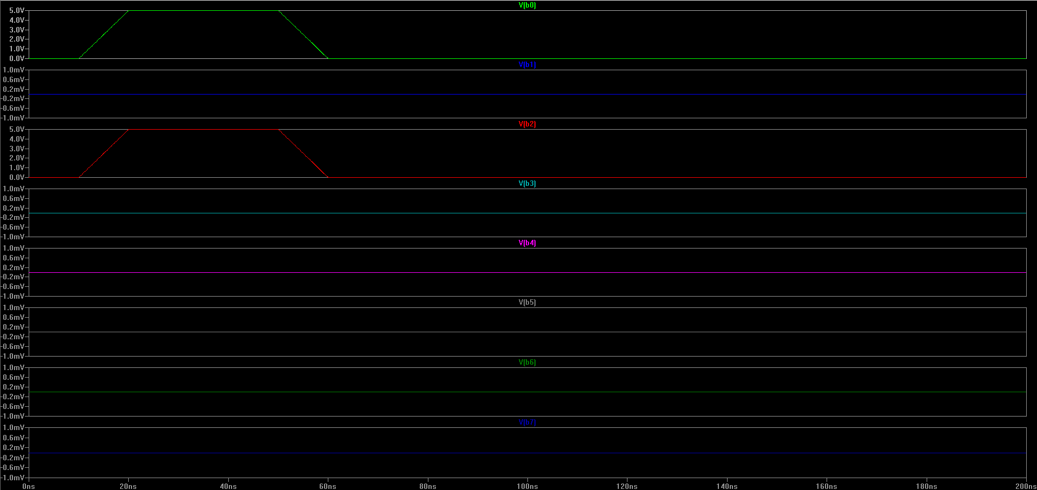
Demonstration of “Greater Than” Last 2 digit of my Student ID= 00011001 > 101=?
Opcode | Operation | Expected Answer | Result of the simulation
1010 | A > B | 0000 0001 | 0000 0001
INPUT B

Slide 31
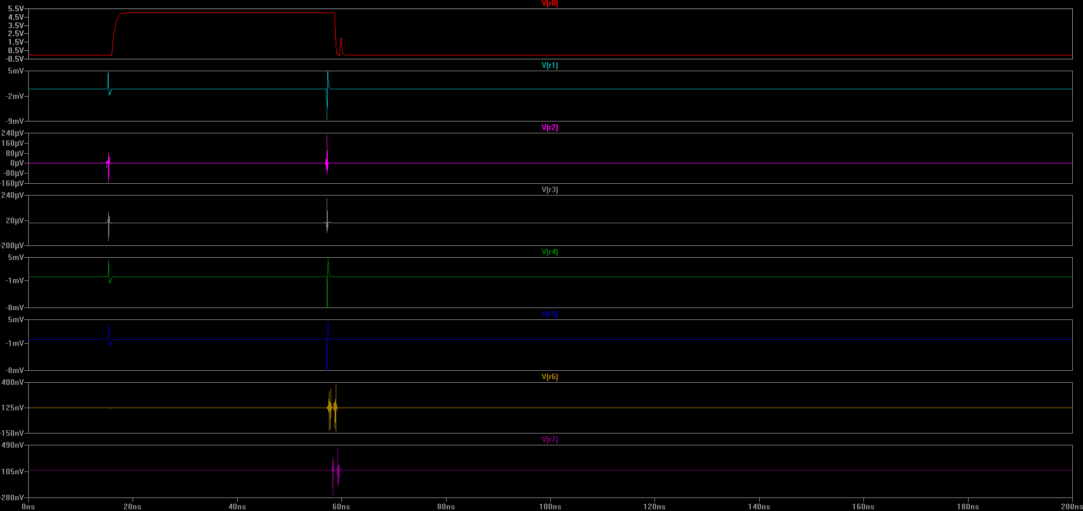
Demonstration of “Greater Than” Last 2 digit of my Student ID= 00011001 > 101=?
Opcode | Operation | Expected Answer | Result of the simulation
1010 | A > B | 0000 0001 | 0000 0001
I used subtractor for «greater than», I checked that whether the flag is high or not.

Slide 32
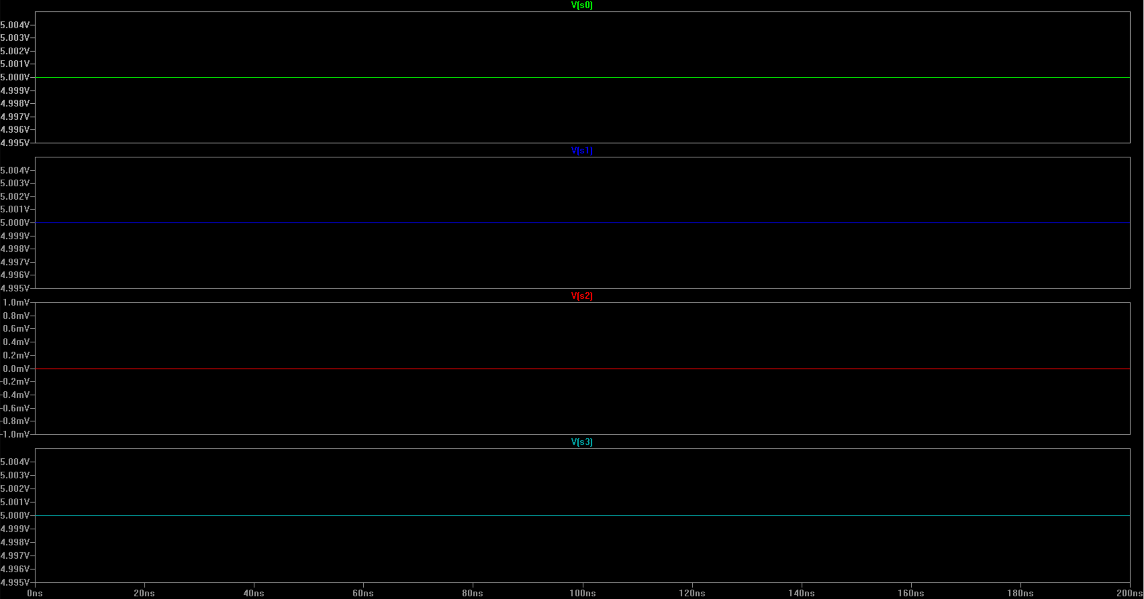
Demonstration of “Less Than” Last 2 digit of my Student ID= 00011001 < 101=?
Opcode | Operation | Expected Answer | Result of the simulation
1011 | A < B | 00000000 | 00000000

Slide 33
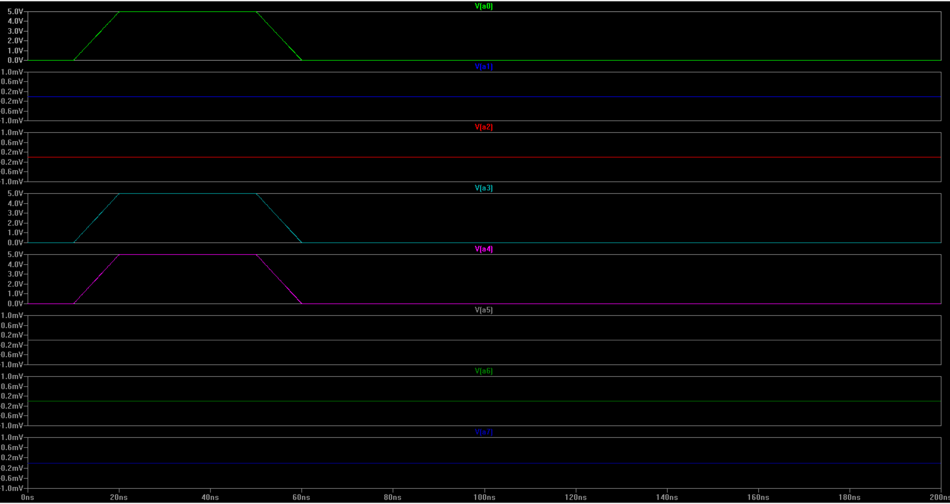
Demonstration of “Less Than” Last 2 digit of my Student ID= 00011001 < 101=?
Opcode | Operation | Expected Answer | Result of the simulation
1011 | A < B | 00000000 | 00000000
INPUT A

Slide 34
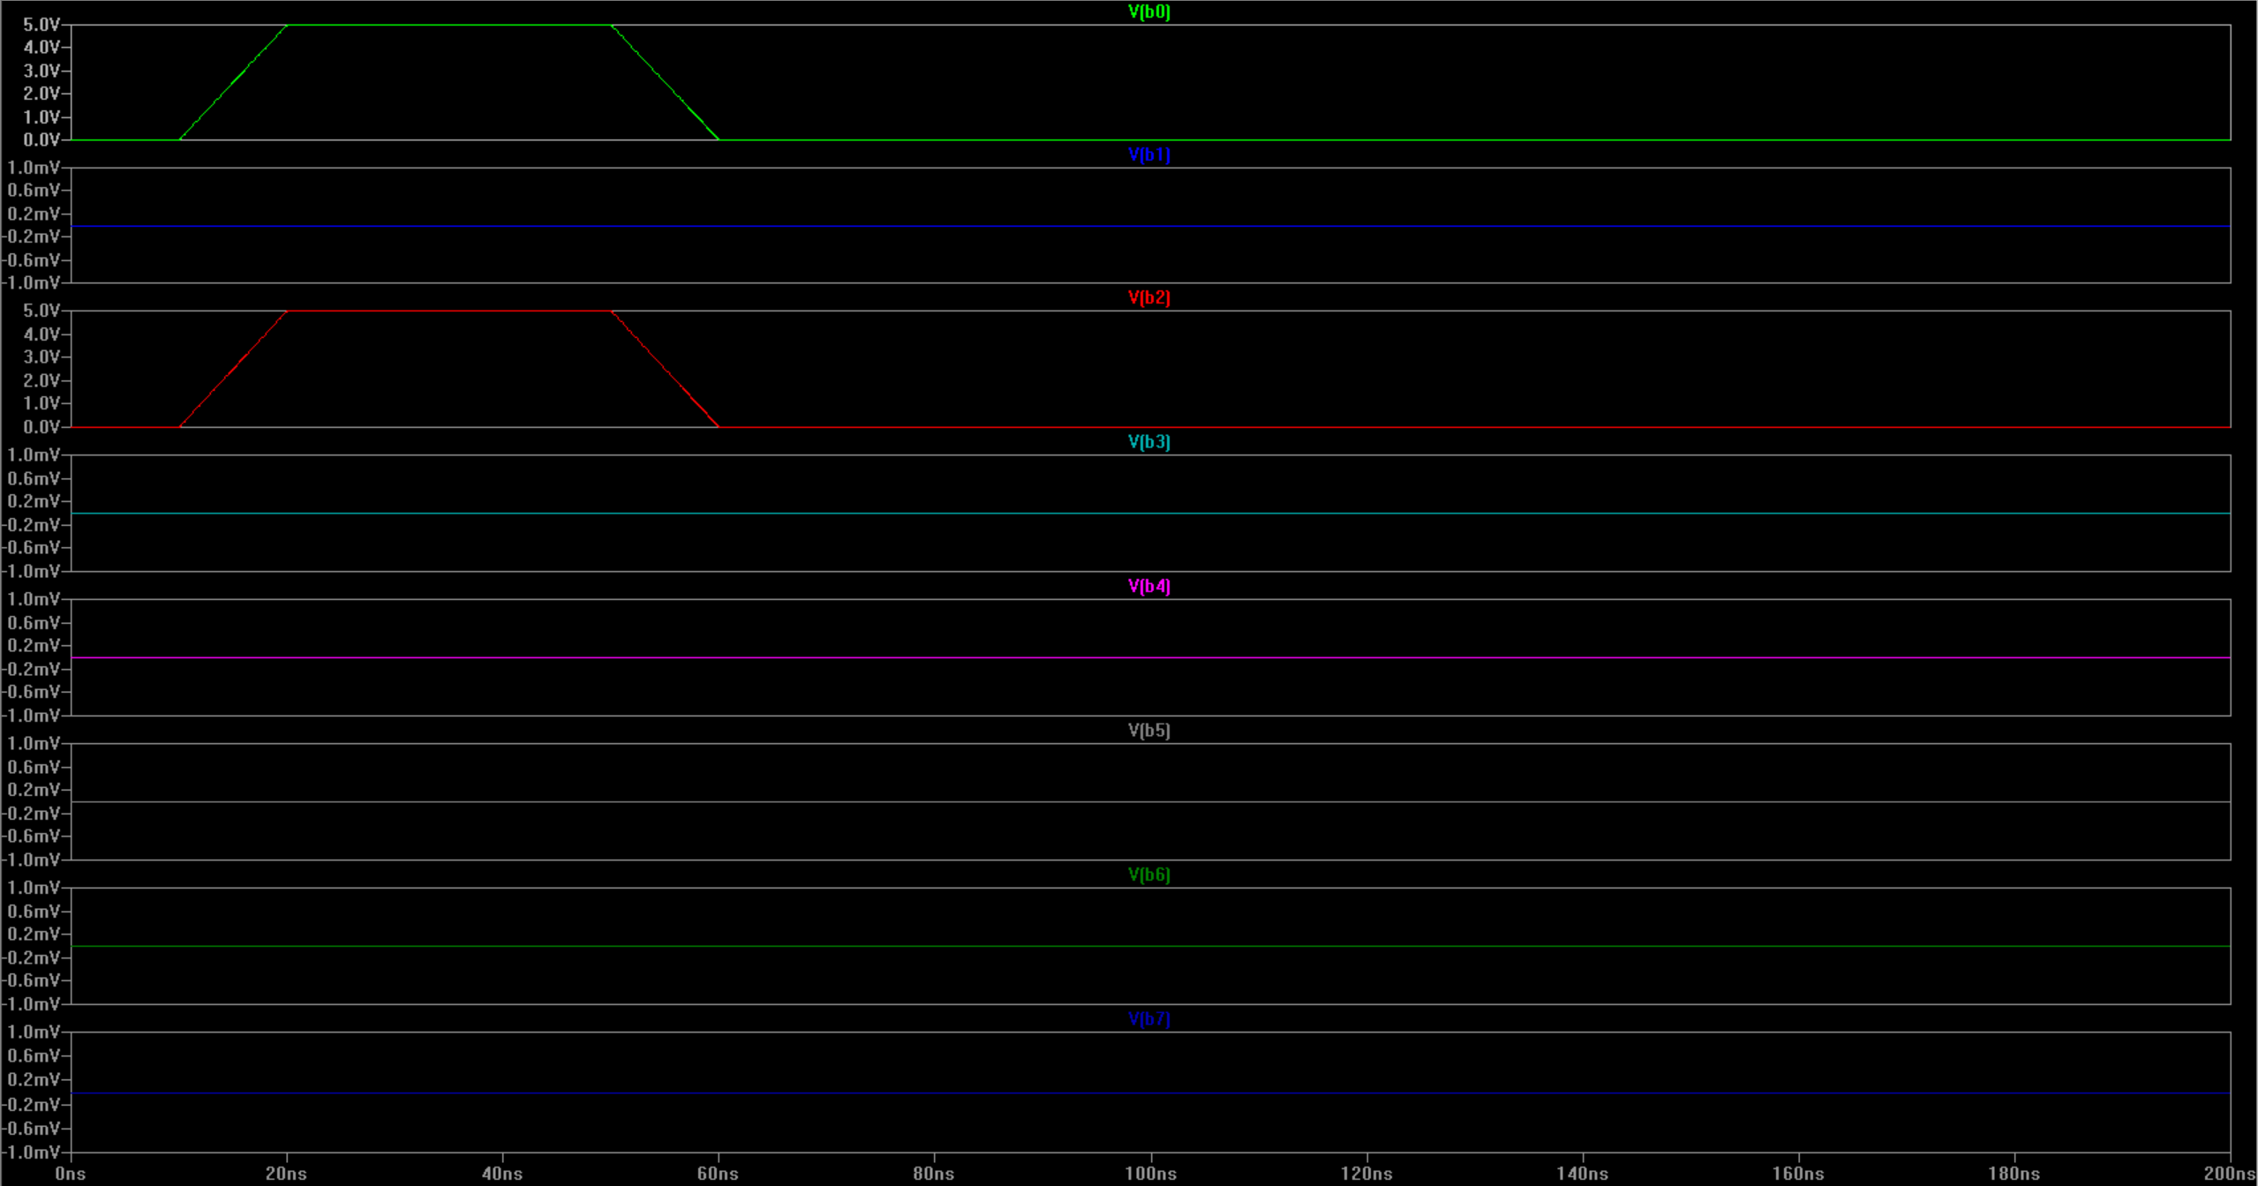
Demonstration of “Less Than” Last 2 digit of my Student ID= 00011001 < 101=?
Opcode | Operation | Expected Answer | Result of the simulation
1011 | A < B | 00000000 | 00000000
INPUT B

Slide 35
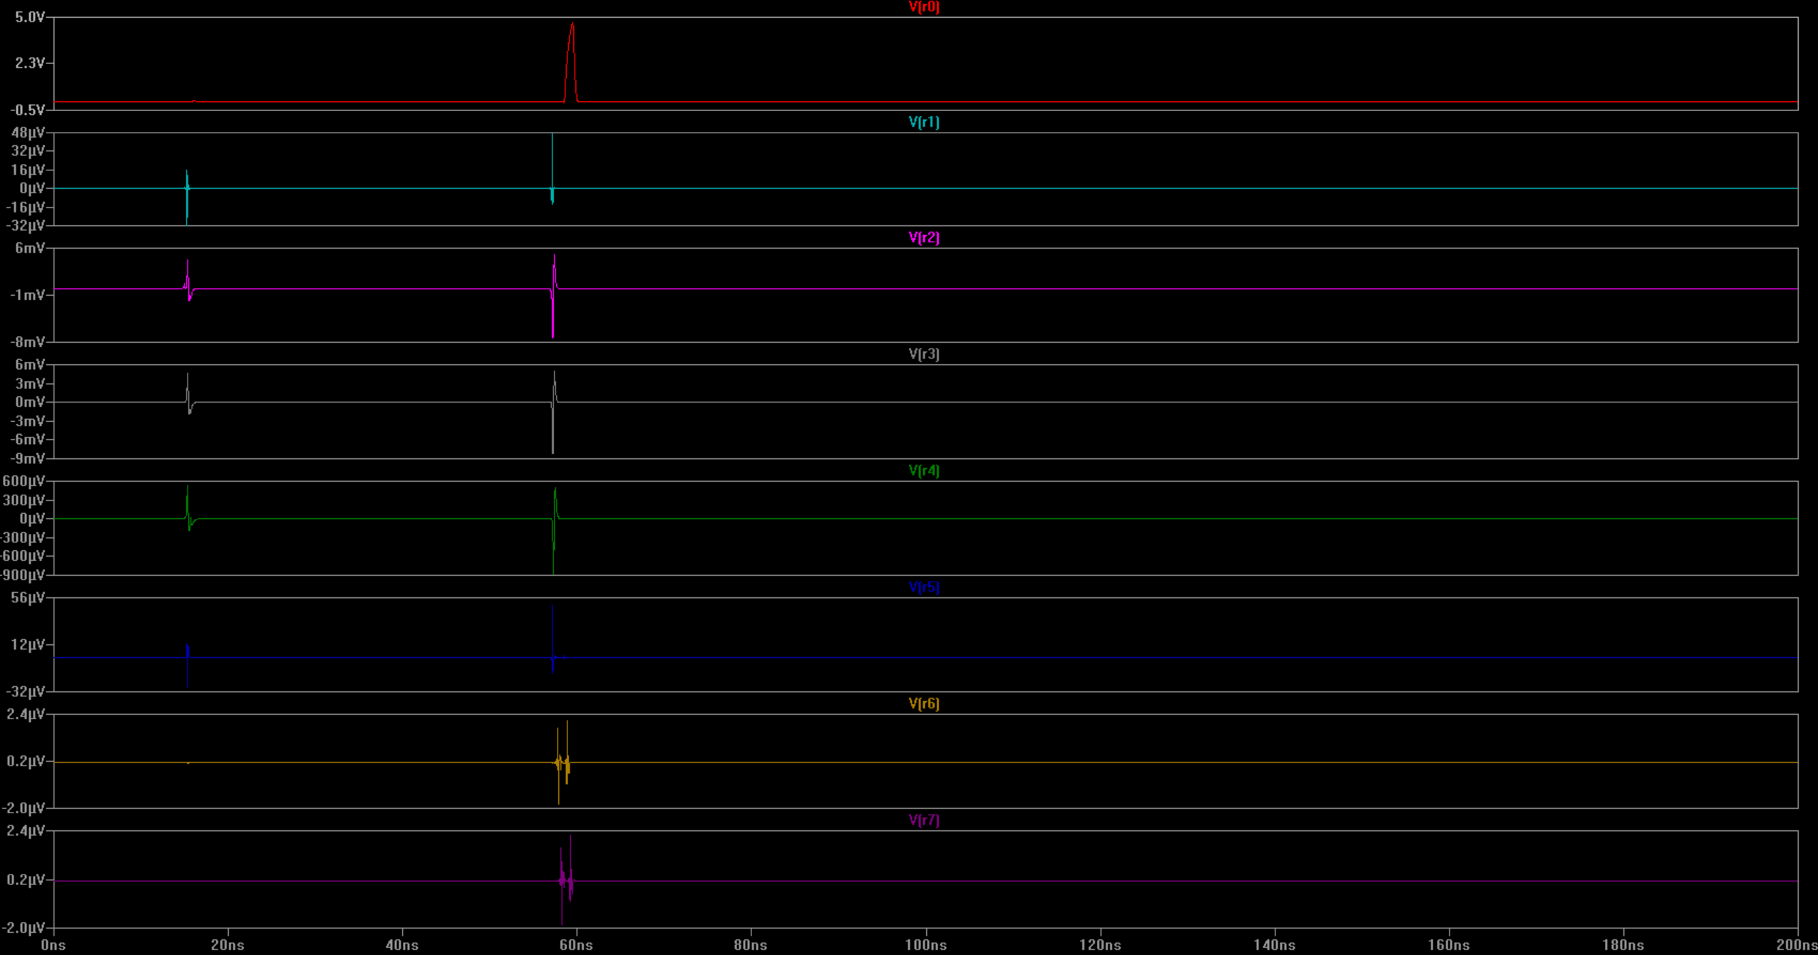
Demonstration of “Less Than” Last 2 digit of my Student ID= 00011001 < 101=?
Opcode | Operation | Expected Answer | Result of the simulation
1011 | A < B | 00000000 | 00000000

Slide 36
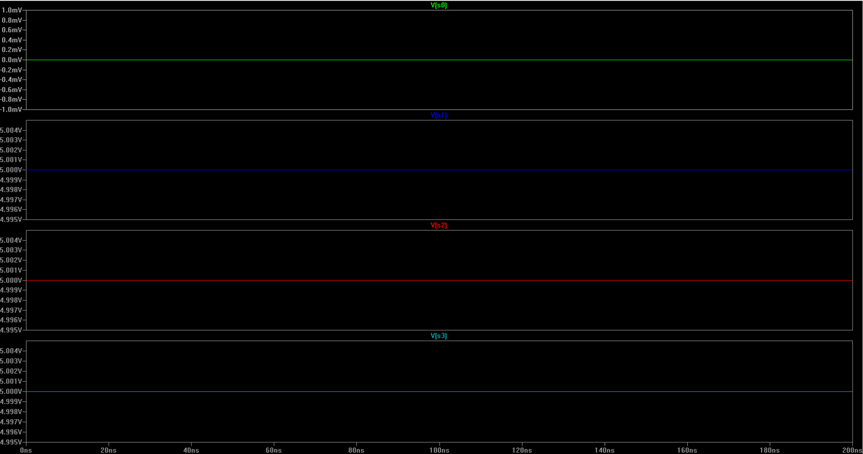
Demonstration of “Arithmetic left shift” Last 2 digit of my Student ID= 00011001 <<<1=?
Opcode | Operation | Expected Answer | Result of the simulation
1110 | A <<< B | 0011 0010 | 00110010

Slide 37
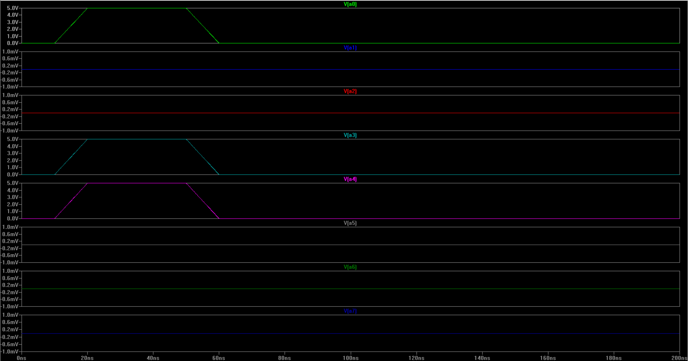
Demonstration of “Arithmetic left shift” Last 2 digit of my Student ID= 00011001 <<<1=?
Opcode | Operation | Expected Answer | Result of the simulation
1110 | A <<< B | 0011 0010 | 00110010
INPUT A

Slide 38
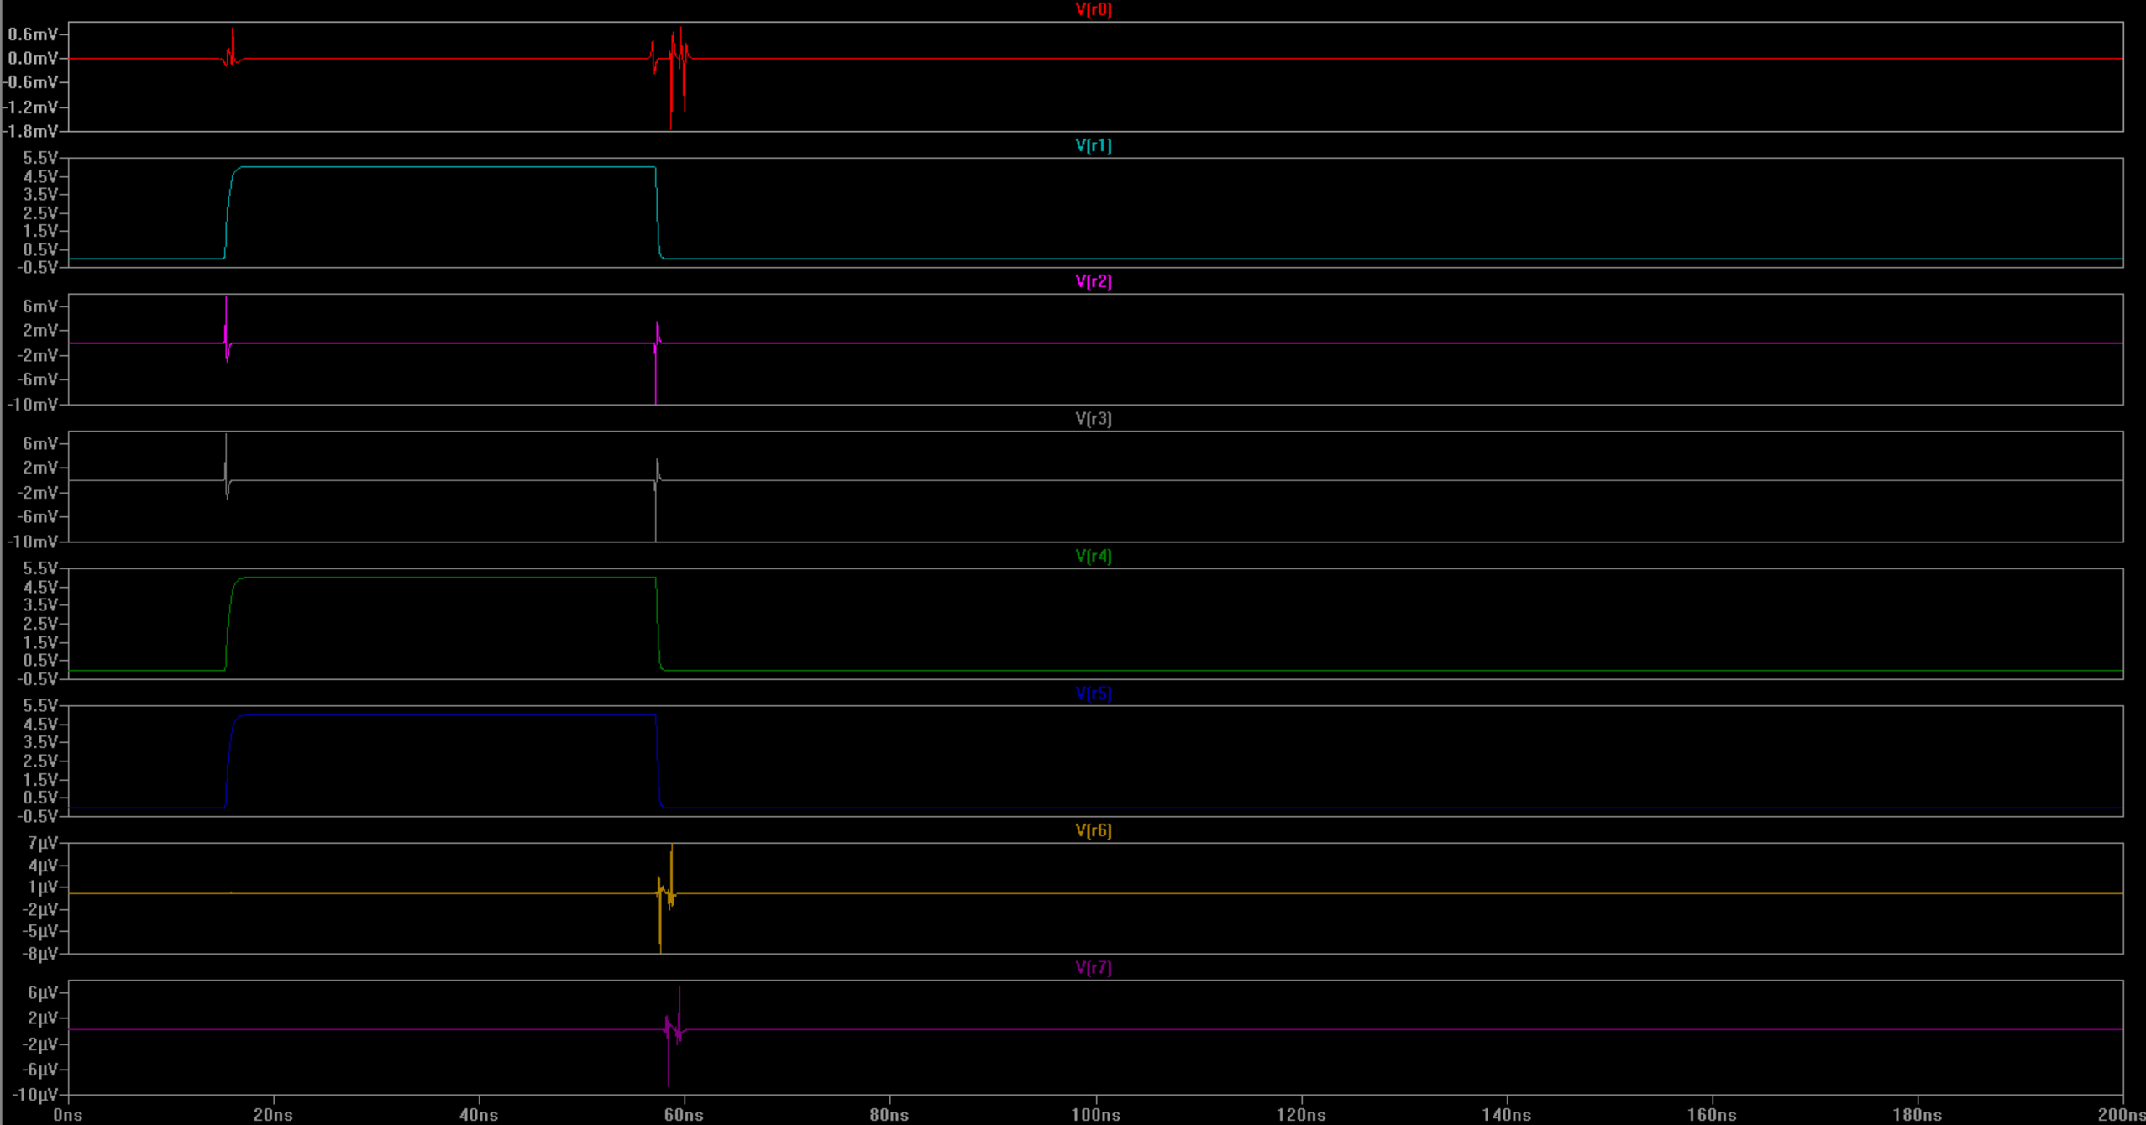
Demonstration of “Arithmetic left shift” Last 2 digit of my Student ID= 00011001 <<<1=?
Opcode | Operation | Expected Answer | Result of the simulation
1110 | A <<< B | 0011 0010 | 00110010
I did a simple design for shift operations. I just used buffer therefore it become fast and simple.

Slide 39
Demonstration of Novel Approach
In this work, a static CMOS design approach was used throughout the entire system. All logic blocks were implemented using static CMOS topology to ensure reliable operation, low static power consumption, and robust noise margins. For multiplexing operations, transmission gate–based structures were preferred instead of conventional CMOS logic in order to reduce transistor count and improve signal integrity.
During testing, intentional delays were introduced at the input stage to analyze dynamic behavior. Rise time and fall time measurements were performed, and it was observed that inserting buffer stages at the inputs significantly improved signal quality. The buffers reduced the effective logical effort seen by subsequent stages, resulting in smoother transitions and reduced delay variations at the outputs.
Each operation was first designed at the 1-bit level, and these building blocks were then combined to form the complete 8-bit data path. This modular approach simplified both verification and layout implementation. Special care was taken to limit the design to a maximum of two metal layers in order to keep routing complexity low and maintain a compact layout structure.
For every functional block, a dedicated schematic was created, followed by a corresponding layout design. After layout completion, a Netlist Consistency Check (NCC) was performed to verify the correctness between schematic and layout. All operations were successfully implemented except for the multiplication unit, which could not be fully completed due to its higher structural complexity.

Slide 40
Conclusion
In this project, a complete 8-bit ALU was designed and implemented using static CMOS technology. All fundamental logic and arithmetic operations, including addition, subtraction, logical operations, shifting, and comparison, were successfully realized and verified. The design was constructed using a fully custom approach, where each functional block was developed from scratch and combined to form a complete data path. A custom cell library was created and utilized throughout the design, allowing full control over layout structure and signal behavior.
Although the multiplication operation was planned as part of the design, it could not be fully implemented within the given time frame due to its higher structural complexity and increased design effort compared to other operations. Despite this limitation, all remaining operations were successfully verified at both schematic and layout levels.
Overall, the project demonstrates a complete and functional ALU design using static CMOS logic, emphasizing modularity, layout awareness, and design correctness. The work provides a strong foundation for future extensions, such as completing the multiplier unit or optimizing the design for performance and area.

